Slide 1

B.Tech Project Evaluation, VIII th Sem
Project Title---- Detection of Hate Speech in Multimodal Social Media Posts
Presented by :-
Abhishek Goswami, 2019645386
Ayushi Rawat, 2019593582
Shubham Tongaria, 2019544008
Under the Supervision of:-
Mr. Sushant Jhingran
Sharda University, Gr. Noida
DEPARTMENT OF COMPUTER SCIENCE & ENGINEERING
SCHOOL OF ENGINEERING AND TECHNOLOGY
Feb, 2023

Slide 2
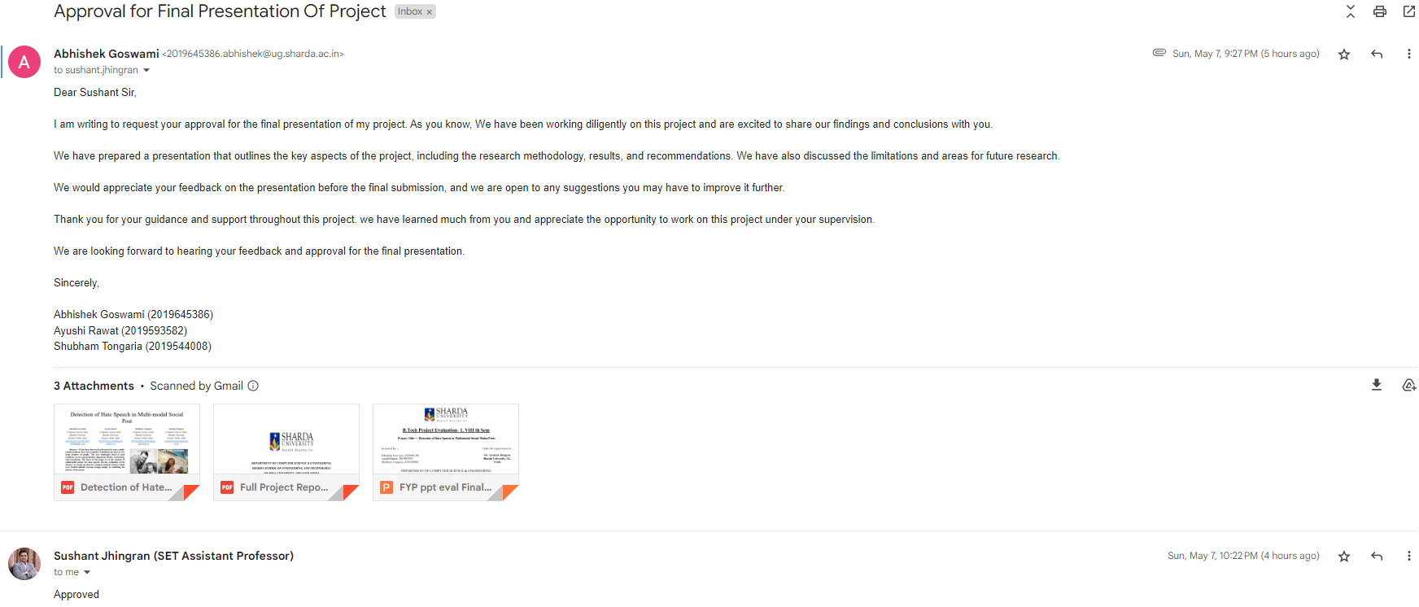
Approval from guide for the evaluation

Slide 3


Slide 4

Abhishek
Goswami
Ayushi Rawat
Shubham Tongaria
Designing various models from scratch
Getting In-Depth Knowledge on Machine Learning techniques
Learning about third party ML toolkits
Researching about Image captioning
Studying and selecting optimal algorithms.
Researching about various models for Sentiment Analysis
Workload
Distribution

Slide 5
Gantt chart
 | Phase 1 |  |  |  |  |  |  | Phase 2
 | 1 | 2 | 3 | 4 | 5 | 6 | 7 | 8 | 9 | 10 | 11 | 12 | 13 | 14
Requirement Analysis
Feasibility Study |  |  |  |  |  | ◆
Getting core team
Selection of Language for code |  |  |  |  |  |  |  |  |  |  | ◆
Model to approcahed for project |  |  |  |  |  |  |  |  | ◆
Setting up datasets
Creating report of all case scenarios
Writing Research Paper

Slide 6
Detection of Hate Speech in Multimodal Social Media Posts

Slide 7


Introduction

Slide 8

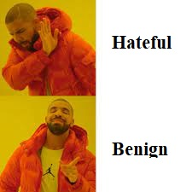
Problem Statement

Slide 9
Related Work
Artificial intelligence
Data Preprocessing
Machine learning
Image Captioning
Deep learning
Sentiment Analysis and Object Detection

Slide 10


Methodology
0
01
02
Image recognition and Captioning
Sentiment Analysis
We directly use the final logits of sentiment analysis models and their sum as the sentiment embedding.
Image Captioning models in our first approach, we use two implementation
The first one is an implementation of Show, Attend, and Tell
Bottom-Up Top-Down
Opportunities of machine learning

Slide 11
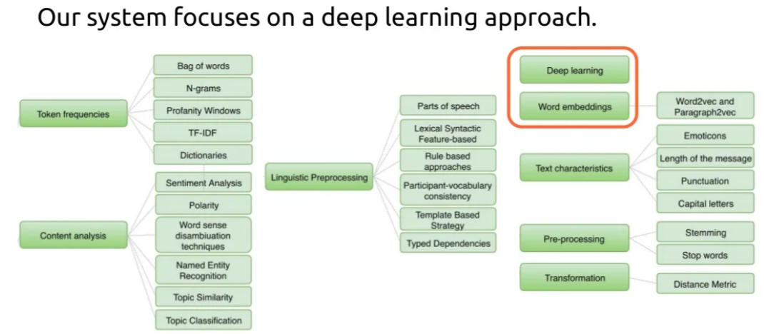

Slide 12
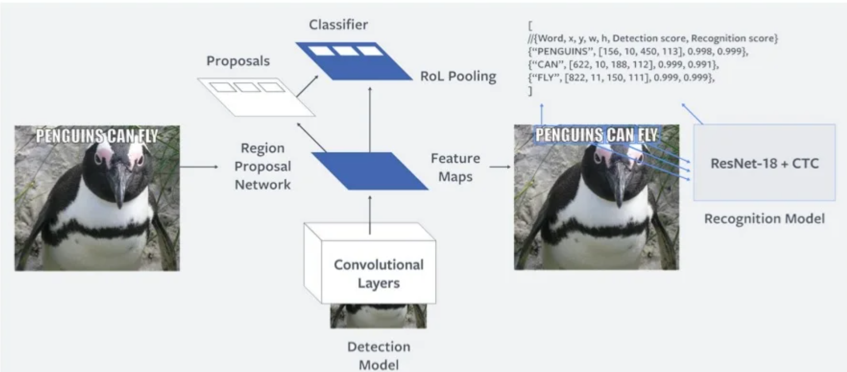
-Analyzing the behavior of visual question answering models, arXiv preprint arXiv:1606.07356, 2016.

Slide 13
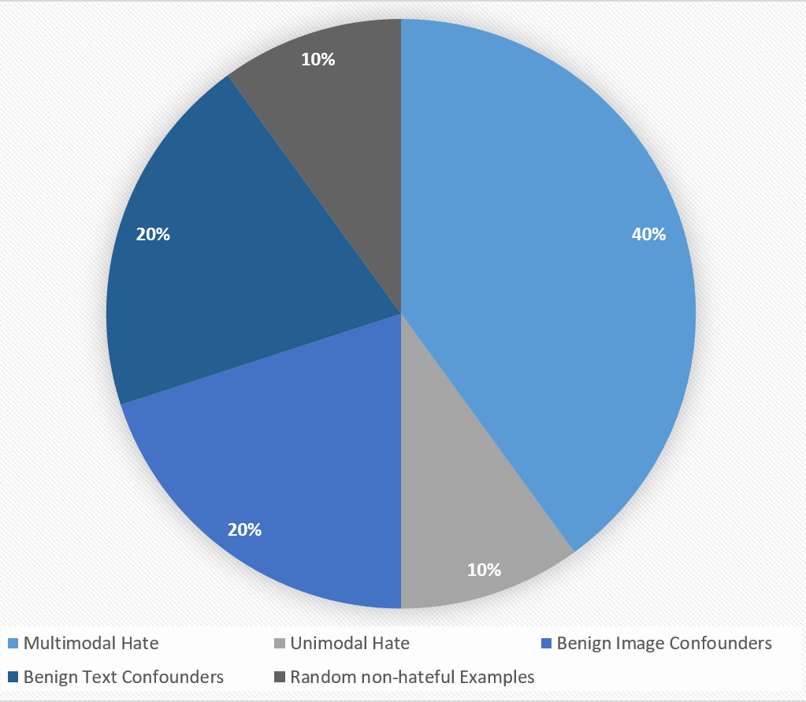
Dataset Analysis
Facebook Hateful Meme Challenge Dataset of 10,000 Memes.
Designed by annotators trained for Hate-Speech.
Fully Balanced Training, Validation and Testing sets.

Slide 14
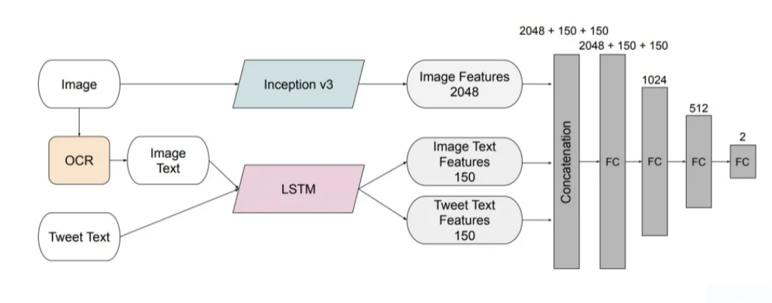
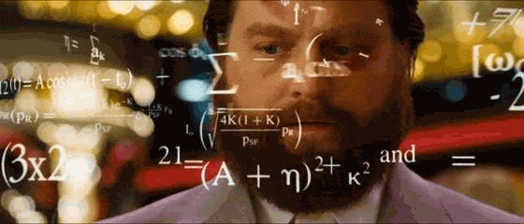
How Image Captioning Work ?
-Visual dialog. In Proceedings of the IEEE Conference on Computer Vision and Pattern Recognition, pages 326–335, 2017.

Slide 15
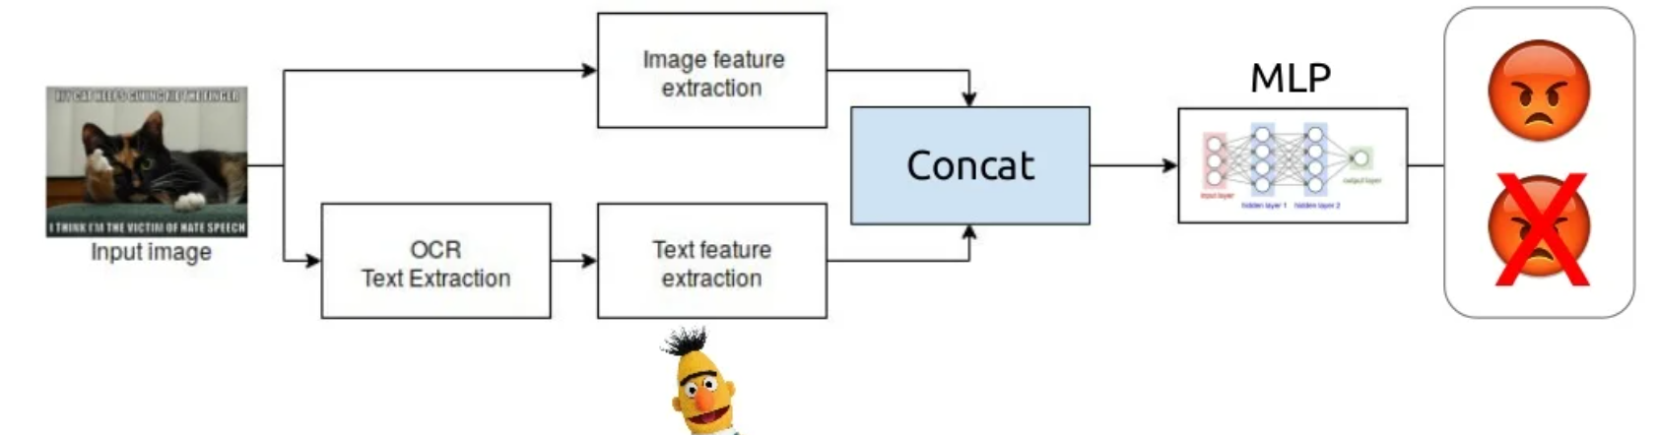
-An empirical study on the effectiveness of images in multimodal neural machine translation. arXiv preprint arXiv:1707.00995, 2017.

Slide 16
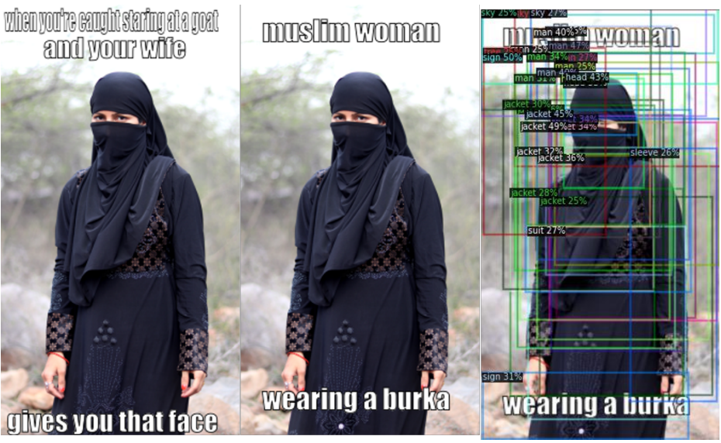
Live Example
1
Image Captioning

Slide 17
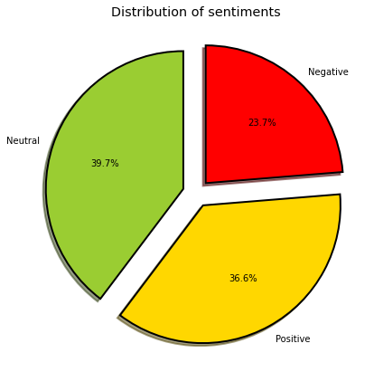
Sentiment Analysis
Sentiment Analysis is the process of ‘computationally’ determining whether a piece of writing is positive, negative or neutral.
We try to implement a Twitter sentiment analysis model that helps to overcome the challenges of identifying the sentiments of the tweets.
The dataset provided is the Sentiment Dataset from twitter which consists of 12,800 tweets .
The model classifies the tweets in three classes : Negative ,Neutral ,Positive

Slide 18
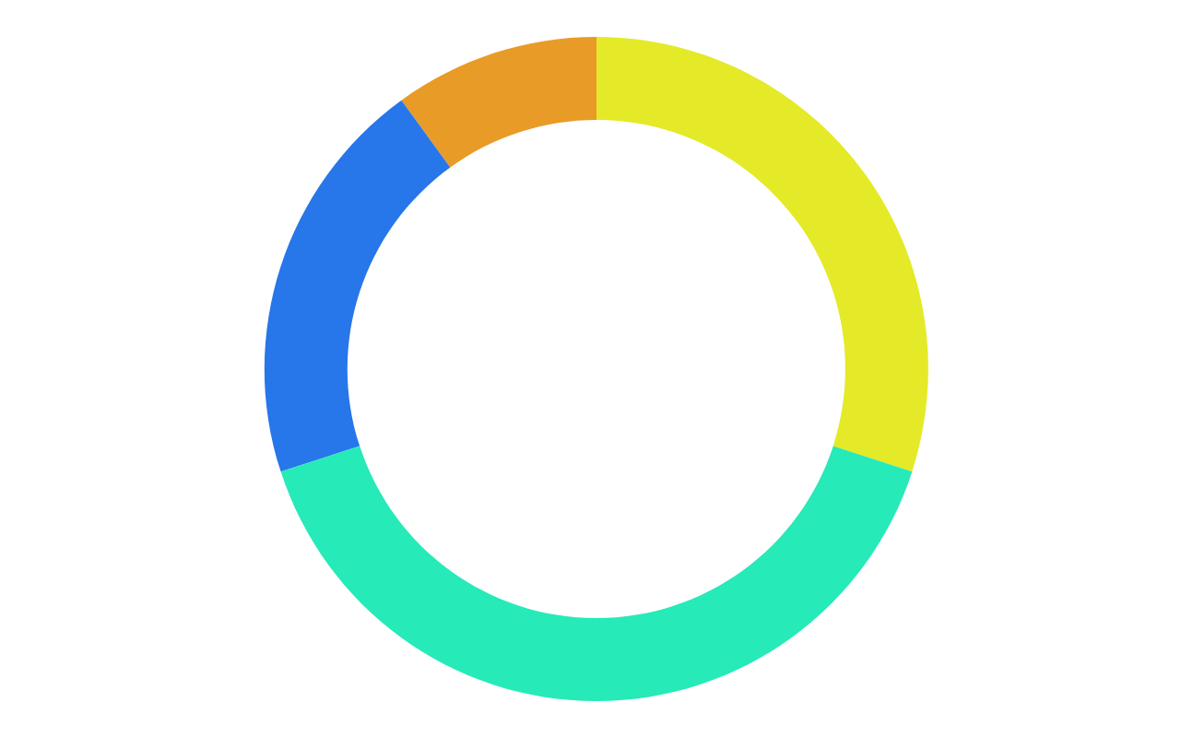
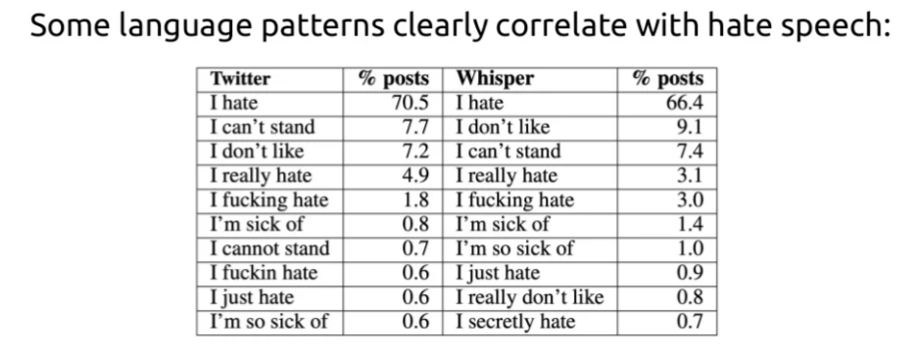
How Sentiment Analysis Work ?
- Automated hate speech detection and the problem of offensive language. In Eleventh international aaai conference on web and social media, 2017

Slide 19
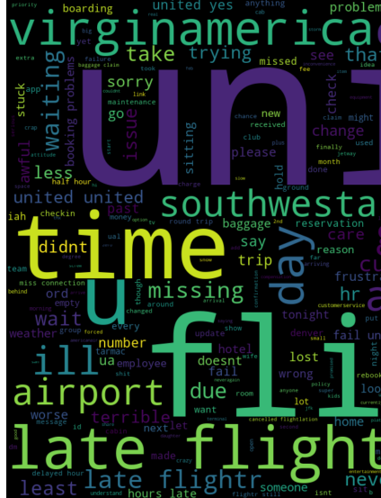
Sentiment Analysis
LinearSVM | Precision | Recall | f1-score | Support
Negative | 0.85 | 0.65 | 0.74 | 238
Neutral | 0.74 | 0.94 | 0.83 | 345
Positive | 0.86 | 0.75 | 0.80 | 305
Accuracy |  |  | 0.80 | 888
Macro Avg | 0.82 | 0.78 | 0.79 | 888
Weighted Avg | 0.81 | 0.80 | 0.80 | 888

Slide 20
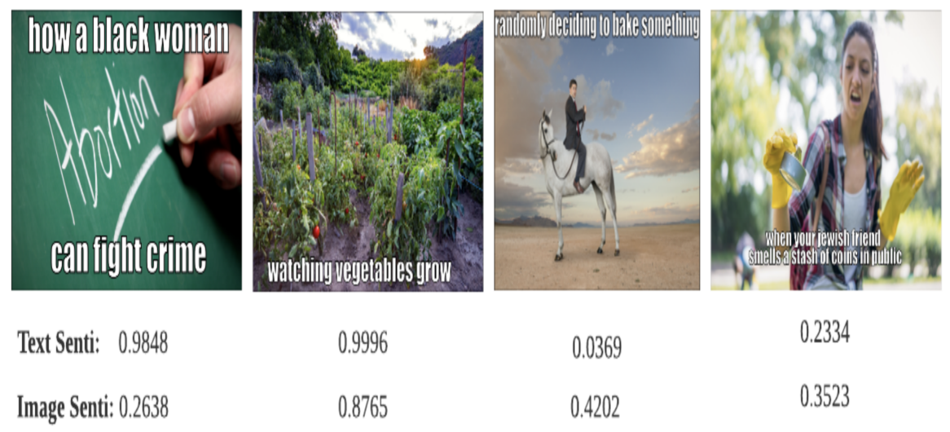
ML for business
- Guesswhat?! visual object discovery through multi-modal dialogue. In Proceedings of the IEEE Conference on Computer Vision and Pattern Recognition, pages 5503–5512, 2017.

Slide 21

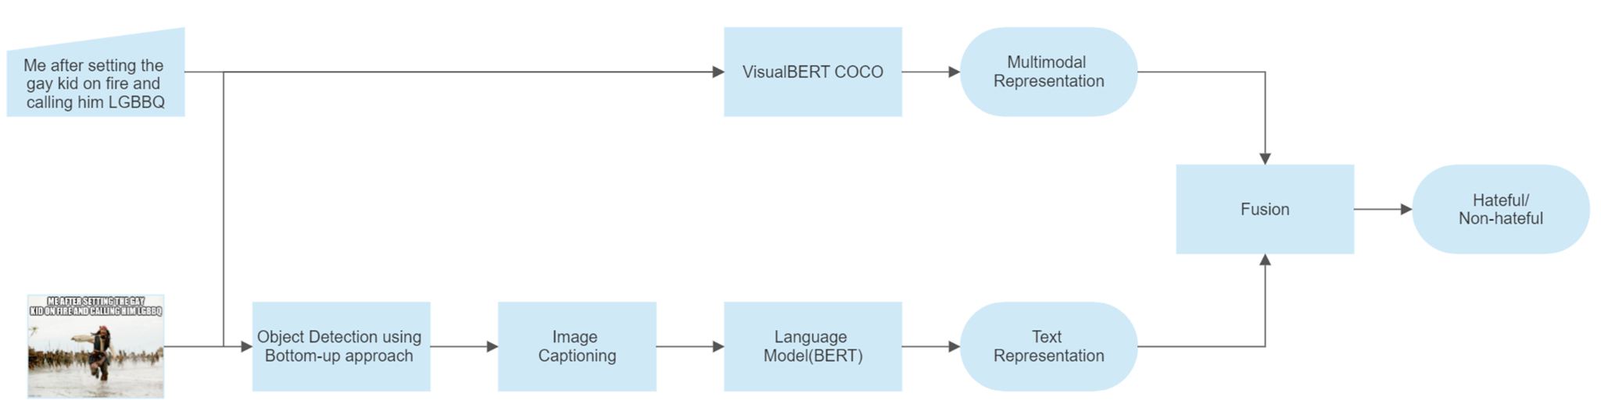
International Conference on Artificial Intelligence, Blockchain, Computing, and Security (ICABCS-2023)
Approach 1
Extracted image text passed to BERT using bottom-up approach.
Dataset fed to VisualBERT for analysis/processing.
Concatenated results classify text as hateful or non-hateful.
Paper title: Detection of Hate Speech in Multimodal Social Media Posts

Slide 22
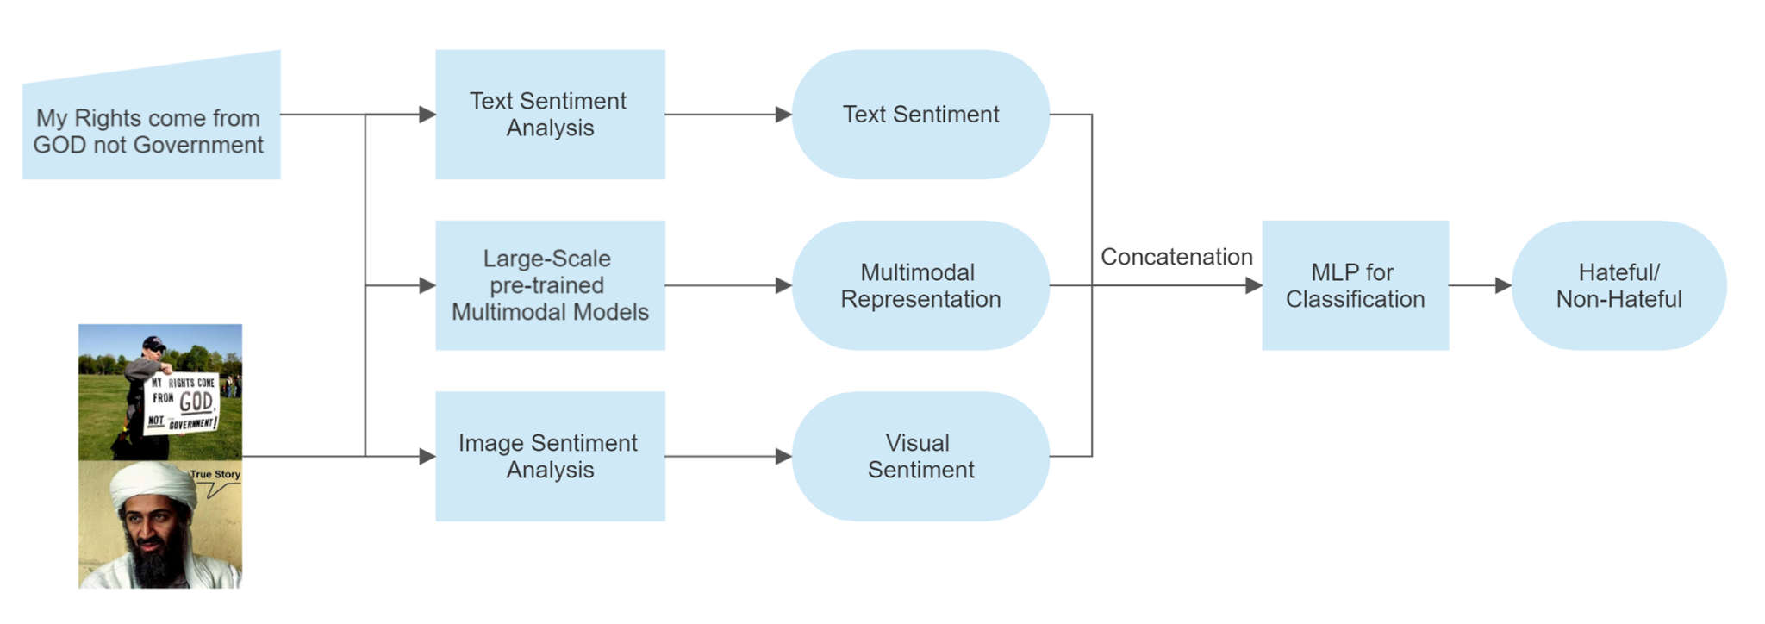
International Conference on Artificial Intelligence, Blockchain, Computing, and Security (ICABCS-2023)
Approach 2
VisualBERT does not always give the best results.
Added sentiment analysis models to improve model accuracy.
The results from all models are then concatenated to classify the text as hateful or non-hateful.
Paper title: Detection of Hate Speech in Multimodal Social Media Posts

Slide 23
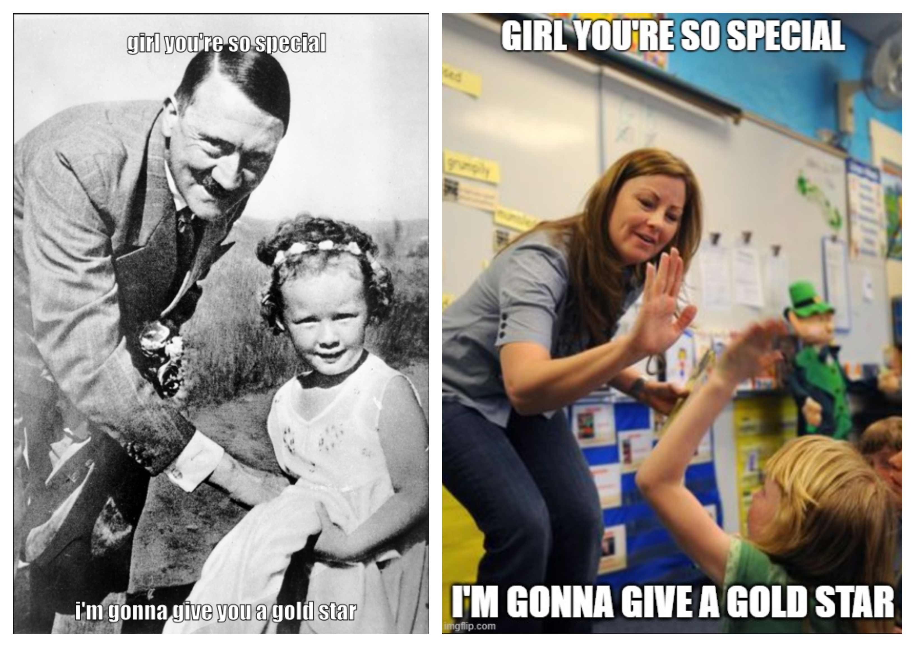
International Conference on Artificial Intelligence, Blockchain, Computing, and Security (ICABCS-2023)
Benefits of Approach 2
Detects irony in multimodal memes with contradictory image and text.
Can detect non-hateful memes.
Sentiment addition improves accuracy by 4%.
Paper title: Detection of Hate Speech in Multimodal Social Media Posts

Slide 24
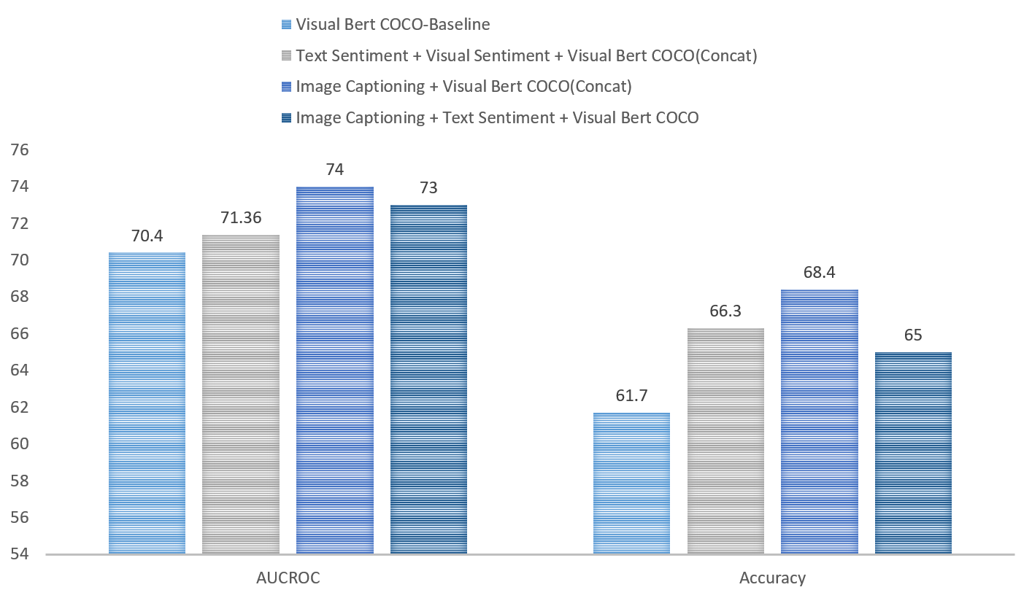
International Conference on Artificial Intelligence, Blockchain, Computing, and Security (ICABCS-2023)
Results
VisualBERT COCO is the Baseline model.
Sentiment + VisualBERT(Concat) shows improvement >4%.
Image Captioning + VisualBERT gives highest accuracy.
Paper title: Detection of Hate Speech in Multimodal Social Media Posts

Slide 25
SR No. | TITLE | YEAR | OUTCOME
1 | Liu, Y., Ott, M., Goyal, N., Du, J., Joshi, M., Chen, D., Levy, O., Lewis, M., Zettlemoyer, L., and Stoyanov, V. Roberta: A robustly optimized bert pretraining approach | 2019 | Performance of Bert model can substantially improve by training model for longer and with larger dataset .
2 | Chen, Y.-C., Li, L., Yu, L., Kholy, A. E., Ahmed, F., Gan, Z., Cheng, Y., and Liu, J. Uniter: Universal image-text representation learning | 2020 | UNITER outperforms state-of-the-art models over multiple V+L tasks by a significant margin.
3 | Automatic Hate Speech Detection using Machine Learning: A Comparative Study | 2020 | SVM and RF algorithms showed better results compared to LR, NB, KNN, DT, AdaBoost, and MLP.
4 | Gomez, R., Gibert, J., Gomez, L., and Karatzas, D. Exploring hate speech detection in multimodal publications. | 2020 | Despite the fact that images are useful for hate speech detection, the multimodal models do not outperform the textual models.

Slide 26
SR No. | TITLE | YEAR | OUTCOME
5 | Shenoy, A. and Sardana, A. Multilogue-net: A context aware rnn for multi-modal emotion detection and sentiment analysis in conversation. arXiv preprint arXiv:2002.08267, 2020. | 2020 | RNN architecture for multi-modal sentiment analysis and emotion detection in conversation.
6 | Sidorov, O., Hu, R., Rohrbach, M., and Singh, A. Textcaps: a dataset for image captioning with reading comprehension, 2020. | 2020 | M4C VQA model when trained with TextCaps and COCO dataset outperforms the old captioning datasets.
7 | José Antonio García-Díaz, Salud María Jiménez-Zafra, Miguel Angel García-Cumbreras, Rafael Valencia-García1: Evaluating feature combination strategies for hate-speech detection in Spanish using linguistic features and transformers | 2022 | Detecting the specific features in hate-speech and if these features provide insights regarding the identification of hate-speech.

Slide 27

Conclusion and Future Directions
application example
01
02
03
Feature engineering
Classification
Venus has a beautiful name, but it’s hot
The Earth is the third planet from the Sun

Slide 28
Conclusion and Future Directions
Polite
Offensive
01
02
03
04
Our approach enables to identify the adversarial examples in the Hateful Memes
The primary objectives of this is to facilitate research for development of true multi-modal models which gives importance to all modalities
Further, we believe that using other Largescale pretrained multi-modal models like UNITER
We present one novel mediums for introducing outside world knowledge to our multi-modal models.

Slide 29



Slide 30


Any Questions ?

Slide 31
